Slide 1


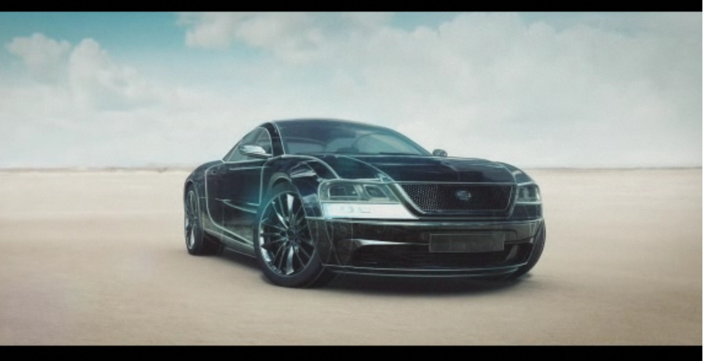
HELLA CONTEST
Technology with Vision
REGISTRATION PERIOD: 11 – 29 MARCH
For more information and registration rules visit us at:
http://ace.ucv.ro//avizier/stiri/index.php?id=120
DO YOU LIKE WORKING WITH SENSORS AND ACTUATORS?
DO YOU LIKE C PROGRAMMING ?
DO YOU LIKE WORKING WITH MICROCONTROLLERS?
FOUND OF EMBEDDED SYSTEMS ?
DO YOU WANT TO DO SOMETHING NEW?
ARE YOU IN A MOOD FOR A CHALLENGE ?
DO YOU LIKE COMPETITION?

